Slide 1
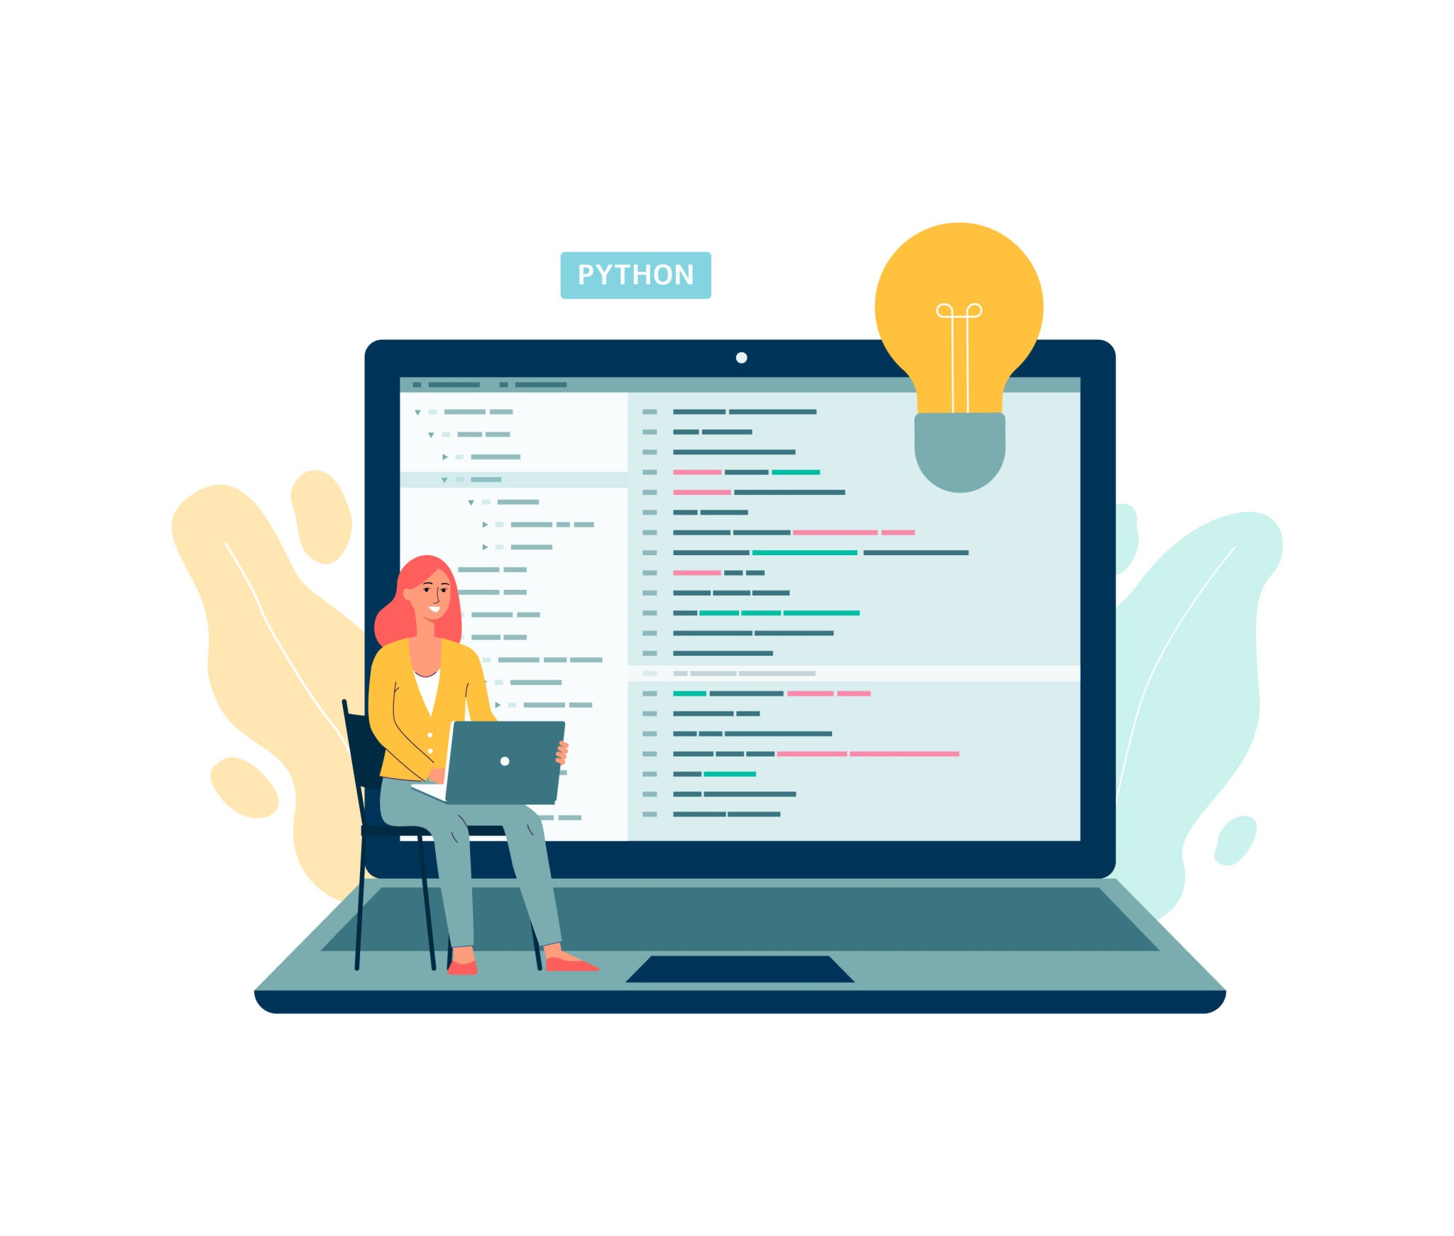
Python Programming
Learning the basics

Slide 2


Learning Intention
Success Criteria
Today we will learn how to display outputs, use inputs, store data in variables, and build simple Python programs.
By the end of this lesson, you will be able to:
use print() to display messages
use input() to ask the user questions
store information in variables
create a simple Python program using inputs and outputs

Slide 3

Todays Keywords
Input
Values which get sent from the user into the computer
Variable
The place where inputs get stored by the program
Output
The values which get sent from the computer to the user

Slide 4

What is Python?
Games
Python is used in gaming to create game features, test games, and control things like scores, menus and player actions
Websites
Python is used by many popular websites and apps to manage data, user accounts, recommendations and features behind the scenes.
Python is a very powerful programming languages that is used to create:
Apps
Python is used in many apps to manage accounts, store data, and power features behind the scenes.
AI Systems
Python is one of the most popular programming languages used to create AI systems such as chatbots, recommendation systems and voice assistants.

Slide 5

What is an Output ?
An input is information sent from the user to the computer.
Programs often need information from the user to work properly.
Examples of inputs:
typing on a keyboard
clicking a mouse
speaking into a microphone
tapping a touchscreen
In Python, we display outputs using: input()
Example:
print(“Hello World”)
This program:
displays the words Hello World

Slide 6
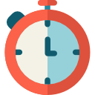

Task One
Level 1 | In Thonny type the following lines of code: print("Hello World") print("My name is ____") print("I enjoy Computing Science")
Level 2 | Create your own program that displays: Your favourite game Your favourite food A message to your class
Start at Level One then keep working through the questions.
Level 3 | Create a program that displays: a title Three different message A blank line between sections
Level 4 | Create a welcome screen for a game that must include: A title Instructions using multiple print statements
Challenge yourself to see how far you can go………
Note: For each level create a new file in Thonny

Slide 7

What is an Input ?
An input is information sent from the user to the computer.
Programs often need information from the user to work properly.
Examples of inputs:
typing on a keyboard
clicking a mouse
speaking into a microphone
tapping a touchscreen
In Python, we display outputs using: input()
Example: input(“What is your name?”)
This program:
displays a question
waits for the user to type an answer

Slide 8
What is a Variable?
A variable is a storage box used to store data in a program.
Programs use variables to remember information.
Example:
a player score in a game
a username
a password
a high score
Example: name = “Mr Wood”
In this program:
name is the variable name
"Mr Wood" is the value being stored
You can think of a variable like:
📦 a labelled box that stores information

Slide 9
What is a Variable?
Example:
name = input(“What is your name?”)
print(name)
What happens here?
Step 1 - Python asks the user a question.
Step 2 - The user types an answer.
Step 3 - The answer is stored in the variable called name.
Step 4 - The program displays the stored answer.
Programs become much more useful when we combine:
inputs
variables
outputs

Slide 10
Task Two
Level 1 | Write a program that asks the user for their name.
Level 2 | Write a program that asks a user for their: Name Favourite colour
Start at Level One then keep working through the questions.
Level 3 | Write a program that asks a user for their: Name Favourite colour Then display both answers
Level 4 | Create a small interview program. Ask at least 4 questions and display all answers
Challenge yourself to see how far you can go………
Note: For each level create a new file in Thonny

